Slide 1

Tacoma Widget Factory What’s Happening Now?
Mike Murnane | City of Tacoma | WAURISA May 24, 2016
Notes:
What are widgets? Widgets are “magic” buttons from ESRI’s free Web AppBuilder that perform mapping tasks like geocoding and measuring.
The same generic widget can be reused and configured for both simple and complex mapping applications.
So, can we please both users & developers with widgets that are easy to use within an application (for users) and flexible enough to reuse between applications (for developers)? Maybe, qualified Yes ☺
I’ll explain my answer that question by covering our Tacoma’s general WAB experience and then specifically focusing on widgets for adding and identifying map data.

Slide 2
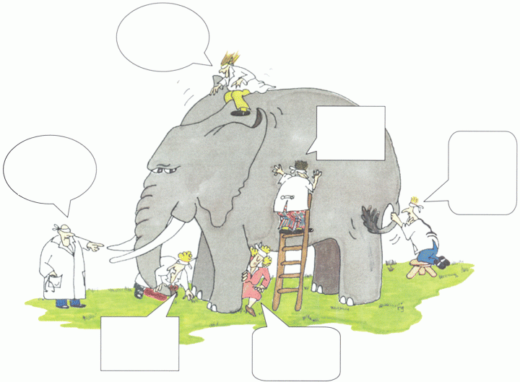
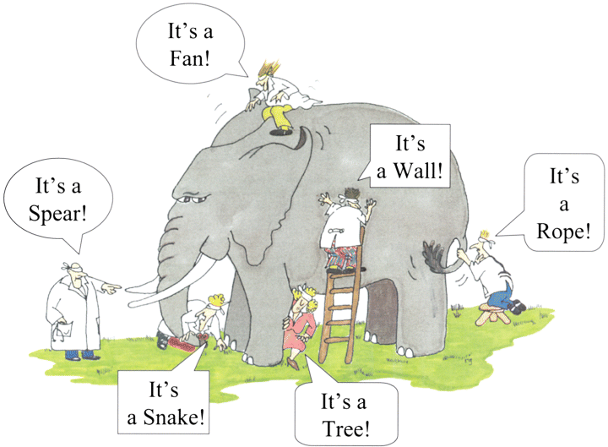
WARNING 1: Scope Creep
No clicks! Voice activated!
Must have a legend!
Hey, this doesn’t look like a giraffe!
This is totally unusable!
Must measure in meters!
Must geocode!
Notes:
Two warnings about WAB. First, WAB will not stop scope creep. It may actually accelerate it (which can be a good thing).
Building an app with a group of people can be like a group blind people trying to describe an elephant – each right & each wrong (what it is or should be).
Scope Creep… Sometimes it is just Rising Expectations … And the app developer is just one of the blind people.

Slide 3

WARNING 2: Accident Free Days
Notes:
WAB will not be an accident free event. May spend a week to find out there is an easier way (a widget already exists, one line of code instead of many).
Knock off the easy stuff, but then the hard work begins.
Not a piano talk - Using WAB does require some hard work, but it can be a useful way to develop apps.

Slide 4

App Development Challenges
Mobile & Desktop | Task Focused-Intuitive | Features Infinite
Notes:
Infinite = magic buttons (# tasks on toolbar), # additional features to the generic task
Developer problem – Instead of making every application unique, is there a way to create a generic task that is easily scalable for both simple and complex implementations?
Here are two specific examples:

Slide 5
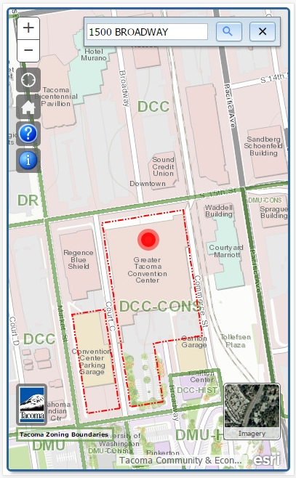
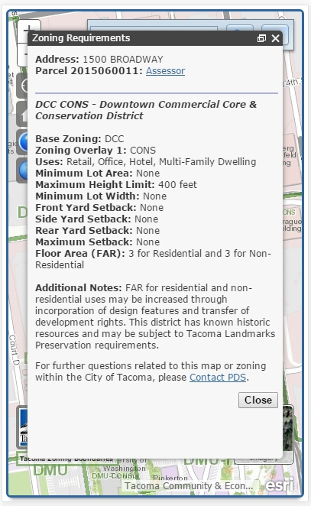
One Focused Task – Zoning Regs
Notes:
Zoning App (What’s allowed on my property) - One map click, locate button click, or address search will result in a detailed report of zoning requires for a location.
The app also includes zoning boundaries and labels (pseudo-legend)

Slide 6
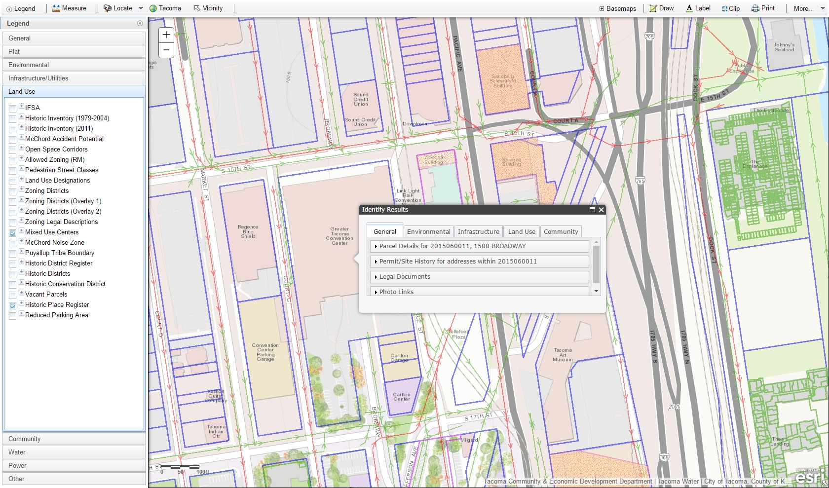
Many Focused Tasks - Permitting
Notes:
Permitting App (What info may pertain to a permit). Lots of buttons with focus tasks (measure, mark up map, clip data, print).
One click to get info on over 30 items (tabs and collapsible panels). Legend with nearly 100 layers.
How can we continue with the common generic task (legend, identify), but provide the ability to add unlimited features? (Avoid scope creep on every app)

Slide 7
ESRI’s Web AppBuilder
Free & Integrated with ArcGIS Online
Run on any device (responsive design)
Simple configuration builder experience (no code to write)
Extend with custom widgets and themes
Notes:
Why use WAB.
#3 – use a web page to make the generic widget work for you specific app (most may want to stop here) Provides the ability to create generic widgets that can be scaled up or down depending on the implementation.
#4 – shareable (very organized - simple as copying widgets into the folder structure)

Slide 8
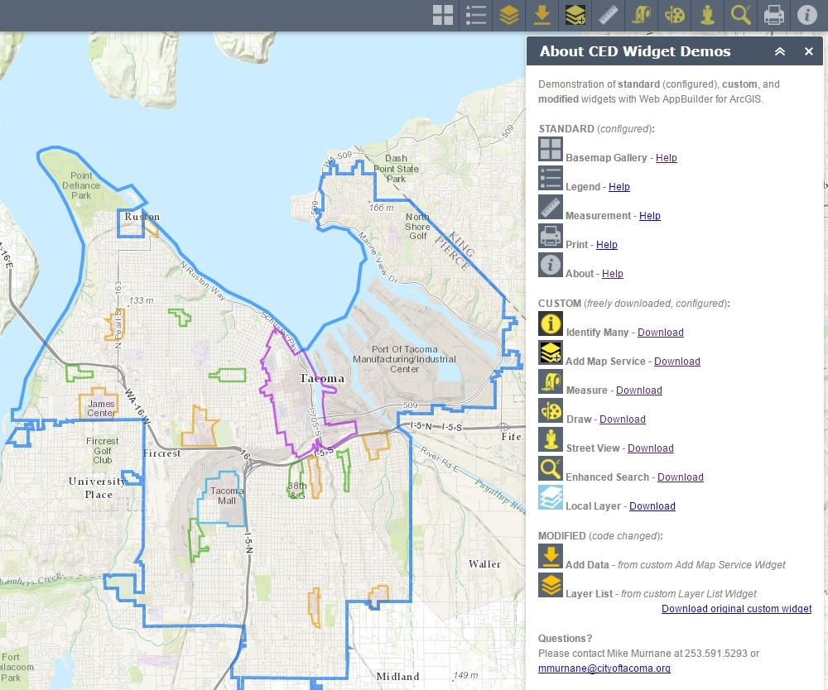
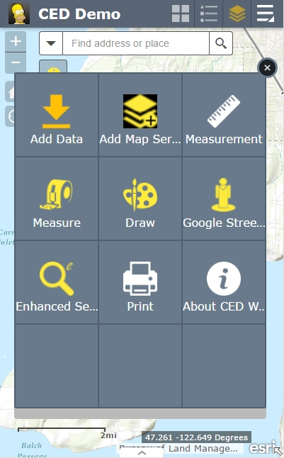
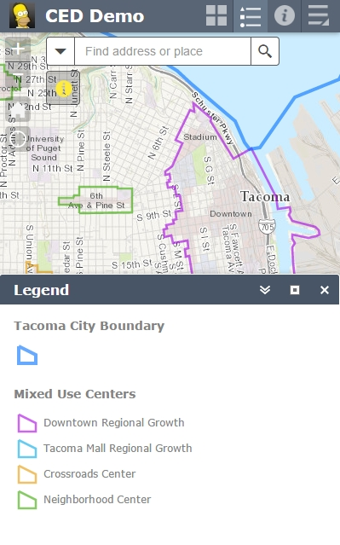
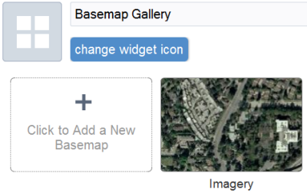
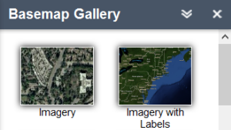
Web AppBuilder Features
Notes:
Widget: button (big) & panel (fits)
Number of widgets already freely available from ESRI & the User Community
Set-Up: Simple as web page configure

Slide 9
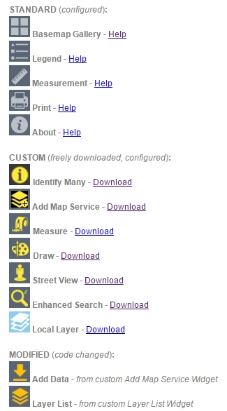
Standard & Custom Widgets
Freely available, no code to write, just configure
Notes:
Able to reproduce most of the tasks in our complex permitting app
Over 50 standard widgets from ESRI (40 2D, 10 3D), at least that many from the user community
Local Layer (Adam Drackley, Robert Scheitlin) lets you compose the map outside of AGOL

Slide 10
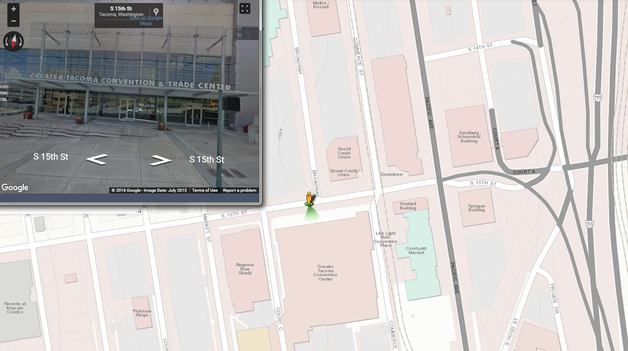
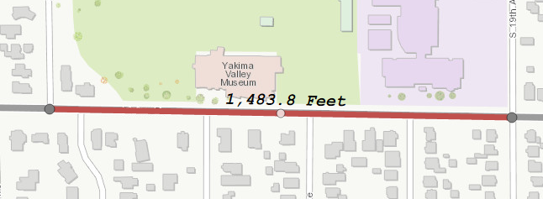
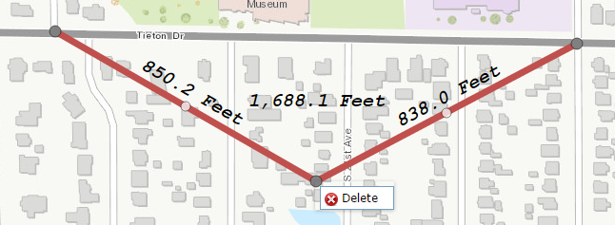
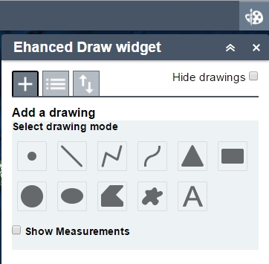
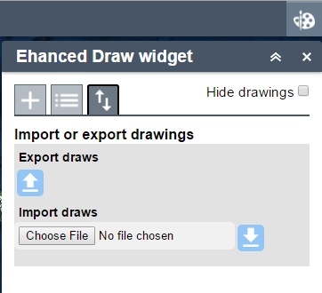
Custom Widget Demo
Measure (Tom Sellste), eDraw (Jeremie Cornet), Street View (Robert Scheitlin)
Notes:
Use these widgets on any map with very little configuration.

Slide 11
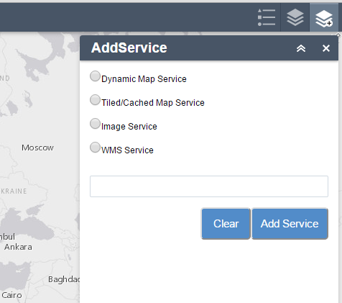
Add Service Widget - Custom
Add a web service - Damien Robinson
Notes:
Powerful widget for adding data from local network or the internet. LIMIT: But what user knows the type of service, let alone remember the URL?
Can wait for ESRI or someone in the user community to create/improve the widget, but if you want to minimize clicks for your users … DIY with JavaScript

Slide 12
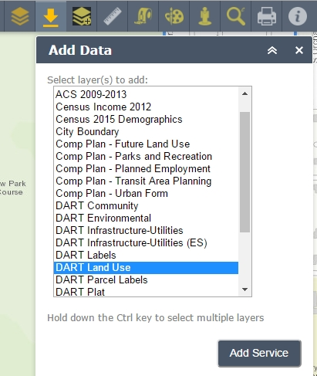
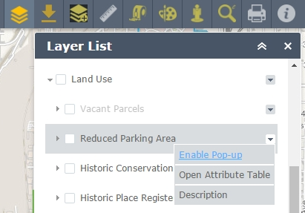
Add Data Widget – Tacoma Built
Combined with Layer List: Unlimited data add & identify
* AddLayer Widget *
(Softwhere Solutions)
released 2/21/2016
GeoNet & GitHub
Notes:
In combo with the custom Local Layer and ESRI Layer List widgets – start with a basic map, add from any web service, and identify any additional data. (AddLayer Widget now available)
Once configurable… the Add Data widget can be use to any list of layers to the map.
Next problem – for a focus task users don’t want to page through every layer in the popup (Scope creep or rising expectations?)

Slide 13
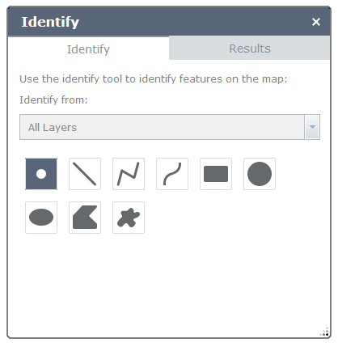
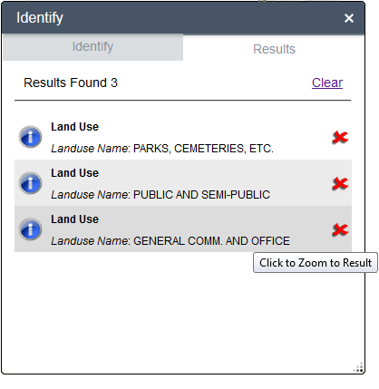
Identify Widget - Custom
Identify many map features - Robert Scheitlin
Notes:
Useful to id some or all features on map with draw tools.
But, Tacoma Zoning, past permits …
Ask a user to draw their parcel boundary? Might tell us that the app is totally unusable!

Slide 14
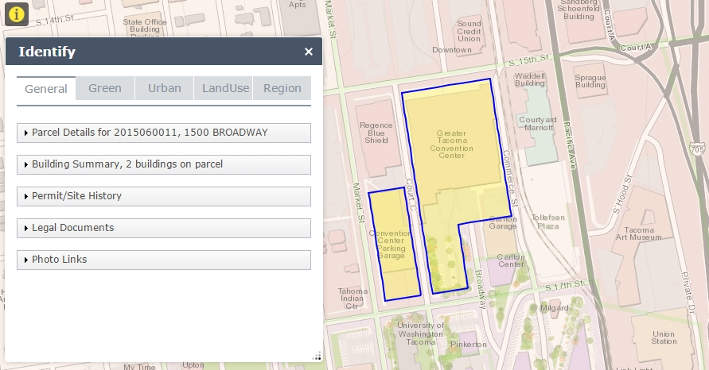
Identify Widget – Tacoma Built
Identify many items within a parcel
Notes:
One click - Info from over 30 datasets arranged vertically (tabs) and horizontally (collapsible bars)
Once configurable… the Identify widget can be use to identify one feature or many feature (with tabs)

Slide 15

Widget Lessons Learned:
Be agile
Design first for mobile
Use configurable widgets
Leverage web services
Begin with complex task
Make task intuitive
Make task generic
Share the widget
Notes:
Be agile: Admit the elephant. Short feedback loop will help all see. ANSWER: Can generic reusable widgets be built for applications that please both users & developers?
Design for mobile (screen size, no mouse-over, fat fingers)
Use configurable widgets (use someone else’s code)
Start with complex task (Widget.js, Widget.html),
Make it intuitive (remove clicks),
Make it generic (common task for all implementations, configurable – js/html)
Leverage web service when ever possible (field names & order, layer, data frame names)
Share (talks, GeoNet, github)

Slide 16
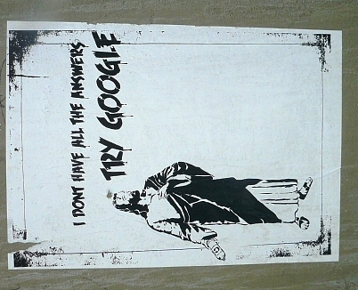

Conclusion: Make widgets intuitive
Notes:
What we should be striving for - Widgets should be intuitive – But how?
Look to Google for examples (What would Google do?)

Slide 17
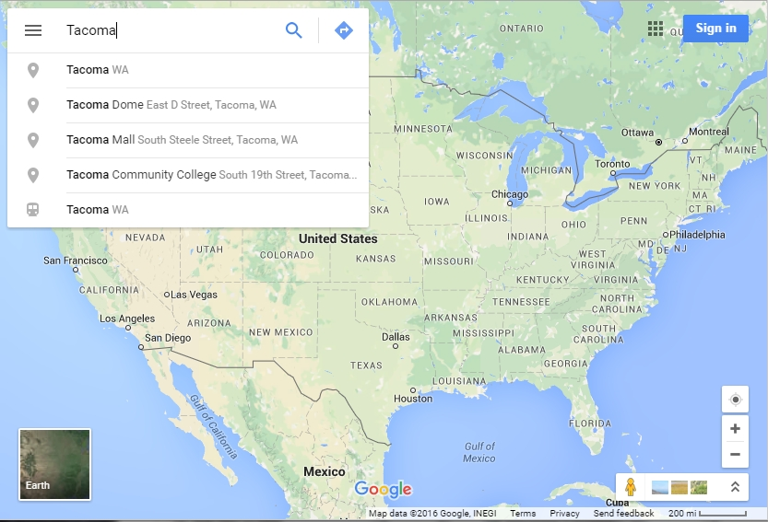
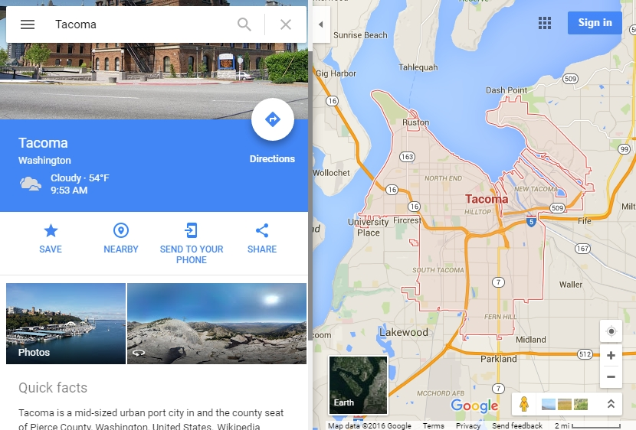
Google Maps: Focused-Intuitive Task
Notes:
Search box is a widget (type or speak) – Look familiar?
(summary of experience headed this way - simple, intuitive, but authoritative source – learn to link many widgets together for one great widget)
Google taking your job? Google showing how to do your job better. Strive for accuracy & simplicity.

Slide 18
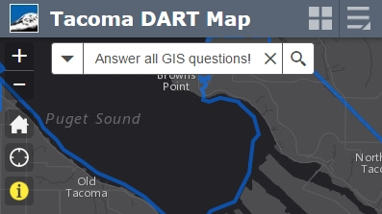
Final Widget?
Answer all my GIS questions!
Notes:
GIS Evolved: Transforming Our World

Slide 19
Resources:
Web AppBuilder for ArcGIS (Developer Edition):
https://developers.arcgis.com/web-appbuilder/
Web AppBuilder on ArcGIS Forum:
https://geonet.esri.com/community/gis/web-gis/web-appbuilder/
GeoNet Custom Widgets:
https://geonet.esri.com/groups/web-app-builder-custom-widgets
GitHub Custom Widgets :
https://github.com/gavinr/wab-widget-search
Rebecca's GIS in Alaska Blog:
https://geonet.esri.com/blogs/myAlaskaGIS

Slide 20

Questions?
Mike Murnane mmurnane@cityoftacoma.org
Senior Technical IT Analyst (GIS)
Tacoma Community & Economic Development
Maps & Data: www.CityOfTacoma.org/maps
Notes:
Questions? Please feel free to email.

